Slide 1


Programming in Java, 2e
Sachin Malhotra
Saurabh Choudhary

Slide 2
Chapter 8
Multithreading In Java

Slide 3
Objective
Understand what are threads and how can it be implemented in Java
Understand how multiple threads can be created within a Java program?
Understand different states of a Thread in Java
Understand the Thread class of java.lang package.
Understand how Runnable interface is helpful in creating threads.
Understand different methods of Threads class, helpful in manipulating threads.

Slide 4
Introduction
A thread is a single sequential flow of control within a program
Multitasking
  Process Based
  Thread Based

Slide 5
Process Vs Thread
If we assume programs as processes, then process based multitasking is nothing but execution of more than one program concurrently.
While the thread based multitasking is executing a program having more than one thread, performing different tasks simultaneously.
Processes are heavyweight task
Threads are light weight tasks

Slide 6
Thread based Multitasking : Multithreading
Multithreading enables programs to have more than one execution paths (separate) which execute concurrently.
Each such path of execution is a thread.
Through multithreading, efficient utilization of system resources can be achieved, such as maximum utilization of CPU cycles and minimizing idle time of CPU.

Slide 7
Thread class
In Java, there is a class named as Thread class, which belongs to java.lang package, declared as,
  public class Thread extends Object implements Runnable
This class encapsulates any thread of execution. Threads are created as the instance of this class, which contains run() methods in it. The functionality of the thread can only be achieved by overriding this run() method.
  public void run( ) {
// statement for implementing thread
}

Slide 8
Methods
run() should be invoked by an object of the concerned thread.
This can be achieved by creating the thread and calling start() on that.
  currentThread(),getName(),
  join(), setDaemon(),
  isInterrupted, isAlive(), interrupt(),
  start(), run(), yield(), sleep(),
  setPriority(), setName(), getPriority(),
  getState() etc

Slide 9
Thread class Constructors
  Thread( )
  Thread(String threadName)
  Thread(Runnable threadObj, String threadName)
  Thread(ThreadGroup threadGroup, String threadName)

Slide 10
Main Thread
Every Java program has a default thread, main thread.
When the execution of Java program starts, the JVM creates the main thread and calls the program's main() method within that thread.
Apart from this JVM also creates some invisible threads, which are important for JVM housekeeping tasks
Programmers can always take control of the main thread.

Slide 11
Main Thread (contd.)
thread object can be created by using the currentThread() method, which returns a reference to the current thread.
The main thread can be controlled by this reference only.

Slide 12
Main Thread (contd.)
Following example code changes the name of main thread from ‘main’ to ‘New Thread’
class MainThreadDemo {
public static void main (String args[] ) {
Thread threadOj = Thread.currentThread();
System.out.println("Current thread: " +threadObj);
threadObj.setName("New Thread");
System.out.println("Renamed Thread: " +threadObj);
} }

Slide 13
The Output
Current thread: Thread[main, 5, main]
Renamed Thread: Thread[New Thread, 5, main]
The first element in the square bracket represents the name of the thread, Second is the priority of the thread set by JVM third is the group name of the thread to which the thread belongs.

Slide 14
Thread creation
By extending the Thread class
By implementing the Runnable interface
Extending the Thread class
Steps to be undertaken for Thread creation
Declare your own class as extending the Thread class.
Override the run( ) method, which constitutes the body of the thread.
Create the thread object and use the start( ) method to initiate the thread execution.

Slide 15
Declaring a class
Any new class can be declared to extend the Thread class, thus inheriting all the functionalities of the Thread class.
class NewThread extends Thread
{
…………………………..
…………………………..
}
Here, we have a new type of thread, named as ‘NewThread’

Slide 16
Overriding the run( )method
The run() method has been inherited by the class NewThread.
The run() method has to be overridden by writing code required for the thread. The thread behaves as per this code segment.
public void run( )
{
//code segment providing the functionality of thread
}

Slide 17
Starting New Thread
Third part talks about start() method, required to create and initiate an instance of our thread class. Following piece of code is responsible for the same
  NewThread thread1 = new NewThread( );
  thread1.start( );
First line creates an instance of class NewThread, where the object is just created. The thread is in newborn state.
Second line, which calls the start() method moves the thread in runnable state, where the java runtime will schedule the thread to run by invoking the run() method automatically.

Slide 18
Implementing the Runnable interface
Runnable interface is implemented by Thread class in the package java.lang. This interface is declared as,
  public interface Runnable
The interface needs to be implemented by any class whose instance is to be executed by a thread. The implementing class must also override a void method named as run(), defined as a lone method in the Runnable interface as
public void run( )
{
…………………
}

Slide 19
Runnable interface (contd.)
The object's run() method is called automatically whenever the thread is scheduled for execution by the thread scheduler.
The functionality of the thread depends on the code written within this run() method.
Other methods can be called from within run().
The Thread will stop as soon as the run() exits.

Slide 20
Runnable interface (contd.)
Once a class that implements Runnable interface is created, an object of Thread class must be instantiated from within that class.
The constructors of Thread class helps in instantiating the object of Thread class.
  Thread(Runnable threadObj)
  Thread(Runnable threadObj, String threadName)
  Thread(ThreadGroup threadGroup, Runnable threadObj)
  Thread(ThreadGroup threadGroup, Runnable threadObj, String threadName)

Slide 21
Runnable interface (contd.)
Even if thread is created, it will not start executing unless the start() method of the Thread class is called. This start() method when called, in turn calls the run().
The program in the next slide illustrates this way of creating thread

Slide 22
Example
class ThreadChild implements Runnable {
ThreadChild() {
Thread t = new Thread(this, "Example Thread");
System.out.println("Detail of child thread :" +t);
t.start(); }
public void run(){
try {
for(int i=1; i<=5; i++) {
System.out.println("\tFrom child thread 1 : i =" +i);
Thread.sleep(1000); }
} catch (InterruptedException e) {
System.out.println("child Thread 1 interrupted"); }
System.out.println("Exit from child Thread 1");} }

Slide 23
Example (contd.)
class ThreadDemo2 {
public static void main(String arg[]) {
new ThreadChild();
try{
for(int m=1; m<=5; m++) {
System.out.println("\tFrom Main Thread : m =" +m);
Thread.sleep(1000);
}
} catch (InterruptedException e) {
System.out.println("Main interrupted"); }
System.out.println("Exit from main thread"); } }

Slide 24
The Output
Detail of child thread :Thread[Example Thread,5,main]
From Main Thread : m =1
From child thread 1 : i =1
From child thread 1 : i =2
From child thread 1 : i =3
From Main Thread : m =2
From child thread 1 : i =4
From Main Thread : m =3
From child thread 1 : i =5
Exit from child Thread 1
From Main Thread : m =4
From Main Thread : m =5
Exit from main thread

Slide 25
Thread.State in Java
Thread.State is an enumeration type declared as follows
  public static enum Thread.State extends Enum
Thread.State has the possible states of a Java thread in the underlying JVM. At any time, a thread is said to be in one of five states :
  New,
  Runnable,
  Not Runnable (Waiting, Timed Waiting),
  Blocked and Terminated

Slide 26
Thread States
New: this state represents the creation of a new thread but does not start it
Runnable: A thread is being executed by the JVM.
Not Runnable: Under this head thread can be in either of the following states,
  Waiting - In this state a thread is waiting indefinitely for another thread to perform a particular action.
  Timed_Waiting - In this state thread is waiting for another thread to perform an action for up to a specified waiting time.
  Blocked: In this state a resource cannot be accessed because it is being used by another thread.
Terminated: Thread execution stops in this stage

Slide 27
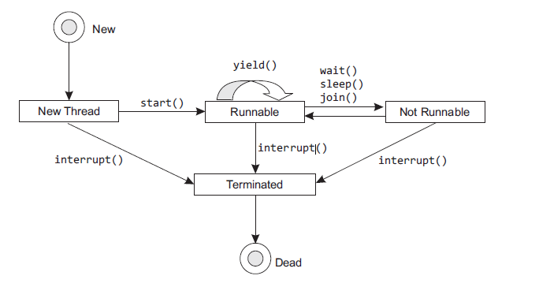
State Diagram

Slide 28
Thread States (contd.)
NEW - In this state, a new thread is created but not started. The following line of code is responsible for the same
  Thread threadObj = new ThreadDemo();
RUNNABLE- From ‘New’ the thread might move to ‘Runnable’ state. Following statements are responsible for doing so.
  Thread threadObj = new ThreadDemo();
  threadObj.start();

Slide 29
Thread states (contd.)
NOT RUNNABLE
From ‘Runnable’ state, a thread might move to ‘Not Runnable’ state.
This state is just a hypothetical state used by us to categorize three valid states of Java.
A thread which is in any of these three states can be assumed to be in ‘Not Runnable’ state. These three states are WAITING, TIMED_WAITING and BLOCKED.

Slide 30
Thread states (contd.)
A thread can move to ‘Terminated’ state, from any of the other states. In this state the thread is dead. This death of a thread can either be natural or forceful.
Natural death occurs when complete run() method is executed
forceful death can be brought about by interrupt() method .
There was one more method, stop(), which has now been deprecated, used to terminate a thread.

Slide 31
Thread Priority
Higher priority threads will always preempt the lower priority threads.
Lower priority threads have to wait until this high priority thread is dead or blocked because of some reason or the other. The reasons for this can be any of the below,
  Thread stops as soon as it exits run( )
  It sleeps (by using sleep( ))
  It waits (by using wait( ) or join())

Slide 32
Thread Priority
setPriority(), responsible for setting the priority of the thread by programmer. The signature is
  final void setPriority(int x)
  Where, x specifies the value used to signify the thread’s priority.
Thread class defines several pre-defined priority constants (as static final variables) as under,
Constant Value
MIN_PRIORITY 1 (minimum priority)
NORM_PRIORITY 5 (normal priority)
MAX_PRIORITY 10 (maximum priority)

Slide 33
Thread Priority
thread’s current priority can be obtained by the getPriority() of the thread class, which returns an integer value.
  final int getPriority()
How to set and get Priorities?
ThreadOne a = new ThreadOne();
System.out.println("Default Priority for thread : " +a.getPriority());
System.out.println(" ");
a.setPriority(Thread.MIN_PRIORITY);
System.out.println("Priority set for thread :" +a.getPriority());

Slide 34
isAlive() & join()
isAlive() method returns a boolean value. It returns true if the thread is active i.e. it has started and not stopped. If it return false, the thread can either be a "New Thread" or "Dead Thread".
isAlive() method can be used to check whether child thread is running or not. The method as defined in Thread class is as follows
  final boolean isAlive()
As far as the join() method is concerned, it waits until the thread on which it is called terminates. It waits for the child thread to terminate and then joins the main thread.

Slide 35
Suspending and resuming a thread
suspend() and resume(), used for suspending an executing threads temporarily and resuming the suspension, respectively.
But since Java1.2, these methods have been deprecated.
These objectives can be achieved by defining your own suspend and resume methods,

Slide 36
Synchronization
Java has such inbuilt mechanism, which lets only one thread use a resource at a time (to avoid inconsistency), known as synchronization.
synchronization can be achieved in two ways
  By using synchronized keyword with method definition
  By using synchronized keyword with any block of code

Slide 37
Synchronized methods
We can make a particular method synchronized by declaring it so, as under,
class Xyz {
synchronized anyMethod() {
…………………………………….
//method body
…………………………………….
} }
Now, if ‘n’ number of threads want to use the method, anyMethod(), the system will not allow them to do so. The highest priority thread will lock the monitor for the method, making it inaccessible to the other threads.

Slide 38
Synchronized statements
We can synchronize a block of code by using the key word “synchronized”. Just like synchronizing a method, here also the word “synchronized” is used before the block of code, to be synchronized. This synchronized statement must specify the object that provides the monitor lock.
public void anyBlock() {
synchronized (this) {
……………………………………………
//statement for the body of block
…………………………………………..
} }

Slide 39
How does Synchronization Work
Monitor is an object that is a mutual exclusive lock on the resource to be accessed.
A monitor can be owned by only one thread at a time. When a thread calls Object.wait() method, it releases all the acquired monitors and is put into WAITING state, until some other thread enters the same monitor and calls notify()/notifyAll().
So, what is notify()? It is the method that when called, wakes up a thread that called wait() on the same object.
notifyAll() will wake up all the threads that called wait() on the same object.

Slide 40
Inter Thread Communications
The communication between the thread, while there simultaneous execution is going on, can be termed inter thread communication.
wait(), notify() and notifyAll() are the methods, which help the threads in communicating with each other.
One important thing is the use of synchronization in communication between threads, as the above three methods are called from synchronized methods and synchronized statements.

Slide 41
sleep() Vs wait()
wait() belongs to Object class while sleep() belongs to Thread class
wait() can only be used from within the synchronized method or statements, sleep() can be used out the synchronized methods and statements also
Wait state can be terminated by calling Object.notify() method while the sleep state can be terminated by invoking interrupt() method of the thread instance

Slide 42
Sleep() Vs wait()
Object.wait() is used in concurrent thread access codes only, while Thread.sleep(int ms) is used wherever and whenever required
wailt() stops the current thread execution and releases the lock of the object. Now other threads can use this released object, while Thread.sleep(int ms) causes the current thread to suspend execution for a specified number of milliseconds. This thread will hold lock it has and it will not release it.

Slide 43
Digital Clock Example
import java.util.*;
class TimeThreadDemo{
Thread t;
TimeThreadDemo(String name){
t = new Thread(new Task(),name);
t.start();}
public static void main(String args[]){
TimeThreadDemo d=new TimeThreadDemo("Digital clock");
}}

Slide 44
Digital Clock Example
class Task implements Runnable{
Calendar c; Date d;
public void run(){
for(;;){
try {
c = Calendar.getInstance();
d = c.getTime();
System.out.println(d);
Thread.sleep(1000);
}catch(Exception e){}
}}}

Slide 45
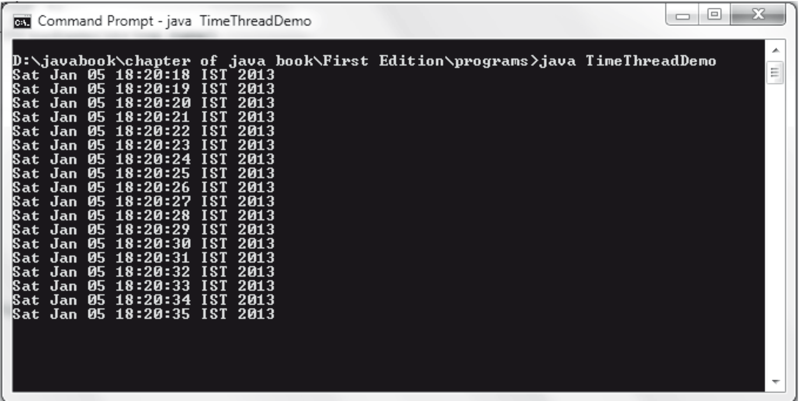
The Output

Slide 46
Summary
Multithreading enables to write such programs which can have more than one thread, each executing simultaneously.
Threads are created as the instances of Thread class, which contains the run() method. Actually the functionality of the thread can only be achieved by overriding this run()method in the class extending the Thread class.
There are two ways of creating a new thread:
  (i) by extending the Thread class or
  (ii) by implementing the Runnable interface which is actually implemented by Thread class.

Slide 47
Summary (contd.)
Thread.State is an enumeration type, which has five possible states.
At any time, a thread is said to be in one of these five states. These states are: New, Runnable, Waiting, Timed_waiting, and Terminated.
Threads in Java run on the concept of preemptive scheduling, done by the Java runtime system by assigning priority to every thread.
There is facility in Java, to synchronize threads so as to avoid unwarranted interleaving between them.

